Slide 1
R
Aluminum stepladders, ladders and scaffolds systems
Confidence in every step!
The Scaffolds Plant “Novaya Vysota” zavodnv.ru/en

Slide 2
R
Single aluminium rung ladder VIRA 4210 Standard
Very lightweight but extremely durable and reliable.
Rungs and stiles made from extruded profiles.
Strong riveting connects rungs and stiles, providing extra reliability and durability.
Rifled rung pitch of 260 mm for maximum safety when ascending the ladder.
Steady plastic end caps ensure positioning without risk of slipping.
Shrink foil packaging to avoid damages.
SKU | Steps | A, m | A1, m | B, m | C, m | C1, m | D, mm | E, mm | F, m | G, m | H, m | Volume, m3 | Weight, kg
4210107 | 1х7 | 1,85 | 0,91 | 2,91 | 0,32 | 0,32 | 50 | 20 | 0,055 | 1,86 | 0,34 | 0,0348 | 2,2
4210108 | 1х8 | 2,11 | 1,15 | 3,15 | 0,32 | 0,32 | 50 | 20 | 0,055 | 2,12 | 0,34 | 0,0396 | 2,5
4210109 | 1х9 | 2,37 | 1,4 | 3,4 | 0,32 | 0,32 | 50 | 20 | 0,055 | 2,38 | 0,34 | 0,0445 | 2,8
4210110 | 1х10 | 2,63 | 1,64 | 3,64 | 0,32 | 0,32 | 62 | 23 | 0,065 | 2,64 | 0,34 | 0,0582 | 3,6
4210111 | 1х11 | 2,89 | 1,88 | 3,88 | 0,32 | 0,32 | 62 | 23 | 0,065 | 2,89 | 0,34 | 0,064 | 4
4210112 | 1х12 | 3,15 | 2,13 | 4,13 | 0,32 | 0,32 | 62 | 23 | 0,065 | 3,15 | 0,34 | 0,0697 | 4,3
4210113 | 1х13 | 3,45 | 2,41 | 4,41 | 0,32 | 0,60 | 62 | 23 | 0,07 | 3,4 | 0,34 | 0,0809 | 5,2
4210114 | 1х14 | 3,71 | 2,65 | 4,65 | 0,32 | 0,60 | 62 | 23 | 0,07 | 3,66 | 0,34 | 0,0871 | 5,5
4210115 | 1х15 | 3,97 | 2,90 | 4,9 | 0,32 | 0,60 | 62 | 23 | 0,07 | 3,92 | 0,34 | 0,0933 | 5,8
4210116 | 1х16 | 4,23 | 3,14 | 5,14 | 0,32 | 0,60 | 62 | 23 | 0,07 | 4,18 | 0,34 | 0,0995 | 6,2
4210117 | 1х17 | 4,49 | 3,39 | 5,39 | 0,32 | 0,65 | 62 | 23 | 0,07 | 4,44 | 0,34 | 0,1057 | 6,6
4210118 | 1х18 | 4,75 | 3,63 | 5,63 | 0,32 | 0,65 | 62 | 23 | 0,07 | 4,70 | 0,34 | 0,1119 | 7
4210119 | 1х19 | 5,01 | 3,88 | 5,88 | 0,32 | 0,65 | 62 | 23 | 0,07 | 4,96 | 0,34 | 0,118 | 7,3
4210120 | 1х20 | 5,27 | 4,12 | 6,12 | 0,32 | 0,70 | 62 | 23 | 0,07 | 5,22 | 0,34 | 0,1242 | 7,7
4210121 | 1х21 | 5,53 | 4,36 | 6,36 | 0,32 | 0,70 | 62 | 23 | 0,07 | 5,48 | 0,34 | 0,1304 | 8
4210122 | 1х22 | 5,79 | 4,61 | 6,61 | 0,32 | 0,70 | 72 | 23 | 0,08 | 5,74 | 0,34 | 0,1561 | 9
zavodnv.ru/en

Slide 3
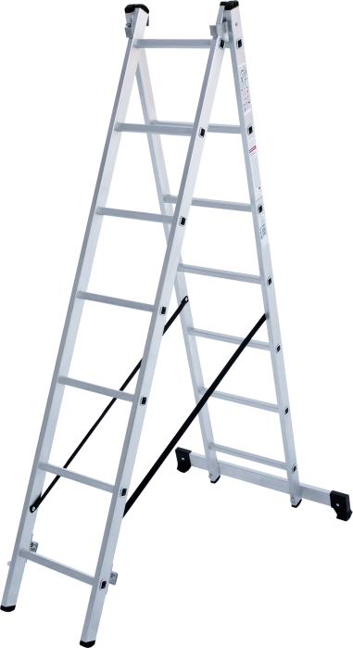
R
Two-section aluminium rung ladder VIRA 4220 Standard
Positions of using: leaning rung ladder, leaning extension rung ladder, stepladder.
Very lightweight but extremely durable and reliable.
Rungs and stiles are made from extruded aluminium profiles.
Strong riveting connects rungs and stiles, providing extra reliability and durability.
Rifled rung pitch of 260 mm for maximum safety when ascending the ladder.
Aluminium stile guides fix extendable ladder section reliably in its position for use.
Automatic locks for hooks.
Optimum stability thanks to wide cross bar.
Steady plastic end cross bar caps prevent risk of slipping.
SKU | Steps | A, m | B, m | C, m | D, m | E, m | F, m | G, m | H, mm | I, mm | J, m | K, m | L, m | Volume, m3 | Weight, kg
4220107 | 2х7 | 1,88 | 1,77 | 3,17 | 4,43 | 3,18 | 0,33 | 0,75 | 50 | 20 | 0,1 | 1,86 | 0,4 | 0,0744 | 5,8
4220109 | 2х9 | 2,4 | 2,26 | 3,66 | 5,16 | 3,96 | 0,33 | 0,75 | 50 | 20 | 0,1 | 2,38 | 0,4 | 0,0952 | 7,1
zavodnv.ru/en

Slide 4
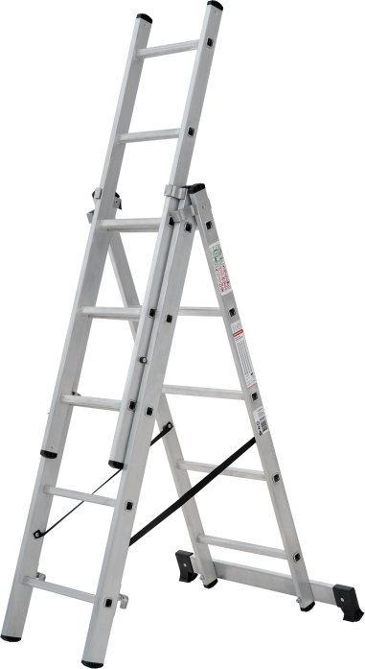
R
Three-section aluminium rung ladder VIRA 4230 Standard
Positions of using: leaning rung ladder, leaning extension rung ladder, stepladder, stepladder with an extendable section, can be used on stairs or steps.
Very lightweight but extremely durable and reliable.
Rungs and stiles are made from extruded aluminium profiles.
Strong riveting connects rungs and stiles, providing extra reliability and durability.
Rifled rung pitch of 260 mm for maximum safety when ascending the ladder.
Aluminium stile guides fix extendable ladder section reliably in its position for use.
Automatic locks for hooks.
Optimum stability thanks to wide cross bar.
Reliably fixed plastic end caps of stiles and cross-bar prevent risk of slipping.
The upper section can be easily pulled out and put up and be used separately as a single leaning rung ladder.
Can be used on steps or stairs by means of upper extendable section.
SKU | Steps | А, m | А1, m | А2, m | А3, m | В, m | С, m | С1, m | С2, m | D1, m | D, m | L, m | M, m | N, m | Volume, m3 | Weight, kg
4230107 | 3х7 | 2,67 | 2,67 | 3,92 | 5,09 | 1,76 | 1,88 | 3,15 | 4,48 | 0,75 | 0,32 | 0,45 | 1,85 | 0,14 | 0,1227 | 8,3
4230108 | 3х8 | 2,92 | 2,92 | 4,17 | 5,33 | 2,01 | 2,14 | 3,41 | 4,74 | 0,75 | 0,32 | 0,45 | 2,11 | 0,14 | 0,1398 | 9,3
4230109 | 3х9 | 3,16 | 3,16 | 4,66 | 6,07 | 2,26 | 2,4 | 3,93 | 5,52 | 0,75 | 0,32 | 0,45 | 2,37 | 0,14 | 0,157 | 10,3
4230110 | 3х10 | 3,41 | 3,41 | 5,15 | 6,82 | 2,51 | 2,67 | 4,45 | 6,31 | 1 | 0,32 | 0,46 | 2,63 | 0,17 | 0,2073 | 12,6
4230111 | 3х11 | 3,66 | 3,66 | 5,66 | 7,55 | 2,76 | 2,93 | 4,97 | 7,09 | 1 | 0,32 | 0,46 | 2,89 | 0,17 | 0,2277 | 13,7
4230112 | 3х12 | 3,91 | 3,91 | 6,15 | 8,29 | 3 | 3,19 | 5,49 | 7,87 | 1 | 0,32 | 0,46 | 3,15 | 0,17 | 0,2482 | 14,8
4230113 | 3х13 | 4,16 | 4,16 | 6,64 | 9,02 | 3,27 | 3,47 | 6,03 | 8,67 | 1 | 0,32 | 0,46 | 3,43 | 0,18 | 0,2942 | 17,3
4230114 | 3х14 | 4,4 | 4,4 | 7,14 | 9,75 | 3,52 | 3,73 | 6,55 | 9,45 | 1,2 | 0,32 | 0,46 | 3,69 | 0,18 | 0,3164 | 18,9
zavodnv.ru/en

Slide 5
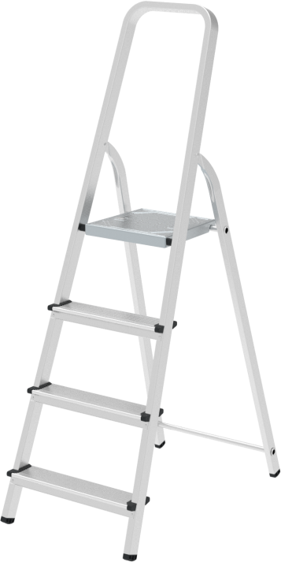
R
Aluminium stepladder VIRA 4110 Standard
Very lightweight but extremely durable and reliable.
Can be easily adjusted and provides high level of comfort.
Steps and stiles are made from extruded aluminium profiles.
80 mm deep wide steps.
Rifled surface of steps for maximum safety when ascending the ladder.
Sturdy six-time riveted step/side rail connection for more stability.
Rifled platform is made from galvanized steel.
600 mm safety barrier.
High-strength belts.
Firm positioning thanks to steady plastic end caps.
Optimised transport dimensions for storage and transportation.
Practicality and attention to every component guarantee safe work at any height.
SKU | Steps | A, m | B, m | C, m | D, m | E, m | Volume, m3 | Weight, kg
4110103 | 1х3 | 0,59 | 1,25 | 0,42 | 2,59 | 0,125 | 0,065625 | 2,6
4110104 | 1х4 | 0,81 | 1,48 | 0,44 | 2,81 | 0,125 | 0,0814 | 3,1
4110105 | 1х5 | 1,03 | 1,72 | 0,47 | 3,03 | 0,125 | 0,10105 | 3,7
4110106 | 1х6 | 1,25 | 1,95 | 0,49 | 3,25 | 0,125 | 0,119438 | 4,5
4110107 | 1х7 | 1,47 | 2,19 | 0,52 | 3,47 | 0,125 | 0,14235 | 5,1
4110108 | 1х8 | 1,69 | 2,42 | 0,54 | 3,69 | 0,125 | 0,16335 | 5,6
zavodnv.ru/en

Slide 6
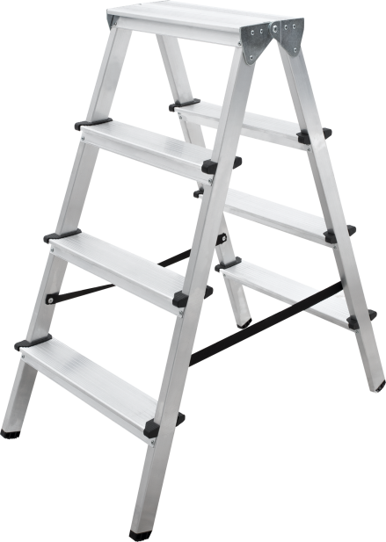
R
Aluminium stepladder VIRA 4120 Standard
Very lightweight but extremely durable and reliable.
Can be easily adjusted and provides high level of comfort.
Steps and stiles are made from extruded aluminium profiles.
80 mm deep wide steps.
Rifled surface of the steps for maximum safety when ascending the ladder.
Sturdy six-time riveted step/side rail connection for more stability.
High-strength belts.
Firm positioning thanks to steady plastic end caps.
Optimised transport dimensions for storage and transportation.
To save the time the double-sided access allows you not to change the position of the stepladder.
Practicality and attention to every component guarantee safe work at any height.
SKU | Steps | A, m | B, m | C, m | D, m | E, m | F, m | G, m | H, mm | Volume, m3 | Weight, kg
4120202 | 2x2 | 0,44 | 0,16 | 0,48 | 0,42 | 0,35 | 0,4 | 2,44 | 0,163 | 0,032861 | 1,9
4120203 | 2x3 | 0,66 | 0,16 | 0,71 | 0,58 | 0,35 | 0,42 | 2,66 | 0,163 | 0,067123 | 2,6
4120204 | 2x4 | 0,88 | 0,16 | 0,95 | 0,74 | 0,35 | 0,45 | 2,44 | 0,163 | 0,114589 | 3,4
4120205 | 2x5 | 1,1 | 0,16 | 1,18 | 0,9 | 0,35 | 0,47 | 2,66 | 0,163 | 0,173106 | 4,2
4120206 | 2x6 | 1,32 | 0,16 | 1,41 | 1,06 | 0,35 | 0,5 | 2,88 | 0,163 | 0,24362 | 5
zavodnv.ru/en

Slide 7
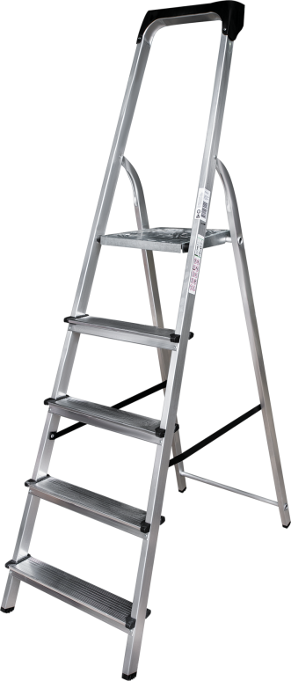
R
Aluminum stepladder with storage tray VIRA 4115 Standard
Spacious storage tray with a bucket for instruments and materials.
Very lightweight but extremely durable and reliable.
Easy to assemble and provides high level of comfort. Steps and stiles are made from extruded aluminum profiles. Wide steps with 80 mm depth.
Rifled surface of steps for maximum safety when ascending the ladder.
Sturdy six-times riveted step/side rail connection for more stability.
Rifled standing platform from galvanized steel.
Safety 600 mm barrier.
High-strength safety belts.
Plastic end caps for a stable position.
Optimized transport dimensions for storage and transportation.
Practicality and attention to each component guarantee safe work at any required height.
SKU | Steps | A, m | B, m | C, m | D, m | E, m | Volume, m3 | Weight, kg
4115103 | 1x3 | 0,59 | 1,29 | 0,42 | 2,59 | 0,125 | 0,067725 | 2,7
4115104 | 1x4 | 0,81 | 1,52 | 0,44 | 2,81 | 0,125 | 0,0836 | 3,2
4115105 | 1x5 | 1,03 | 1,76 | 0,47 | 3,03 | 0,125 | 0,1034 | 3,8
4115106 | 1x6 | 1,25 | 1,99 | 0,49 | 3,25 | 0,125 | 0,121888 | 4,6
4115107 | 1x7 | 1,47 | 2,23 | 0,52 | 3,47 | 0,125 | 0,14495 | 5,2
4115108 | 1x8 | 1,69 | 2,46 | 0,54 | 3,69 | 0,125 | 0,16605 | 5,7
zavodnv.ru/en

Slide 8
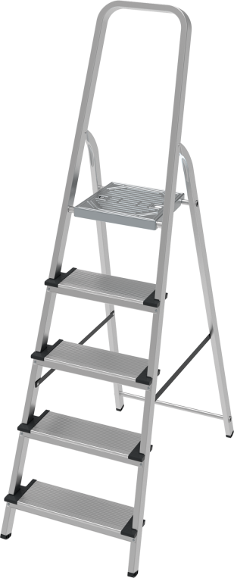
R
Aluminum step 130 mm stepladder VIRA 4117 Standard
Very lightweight but extremely durable and reliable.
Easy to assemble and provides high level of comfort.
Steps and stiles are made from extruded aluminum profiles.
Wide steps with 130 mm depth.
Rifled surface of steps for maximum safety when ascending the ladder.
Sturdy six-times riveted step/side rail connection for more stability.
Rifled standing platform from galvanized steel.
Safety 600 mm barrier.
High-strength safety belts.
Plastic end caps for a stable position.
Optimized transport dimensions for storage and transportation.
Practicality and attention to each component guarantee safe work at any required height.
SKU | Steps | A, m | B, m | C, m | D, m | E, m | Volume, m3 | Weight, kg
4117103 | 1x3 | 0,59 | 1,25 | 0,42 | 2,59 | 0,128 | 0,0672 | 3
4117104 | 1x4 | 0,81 | 1,48 | 0,44 | 2,81 | 0,128 | 0,083354 | 3,8
4117105 | 1x5 | 1,03 | 1,72 | 0,47 | 3,03 | 0,128 | 0,103475 | 4,6
4117106 | 1x6 | 1,25 | 1,95 | 0,49 | 3,25 | 0,128 | 0,122304 | 5,6
4117107 | 1x7 | 1,47 | 2,19 | 0,52 | 3,47 | 0,128 | 0,145766 | 6,5
4117108 | 1x8 | 1,69 | 2,42 | 0,54 | 3,69 | 0,128 | 0,16727 | 7,4
zavodnv.ru/en

Slide 9
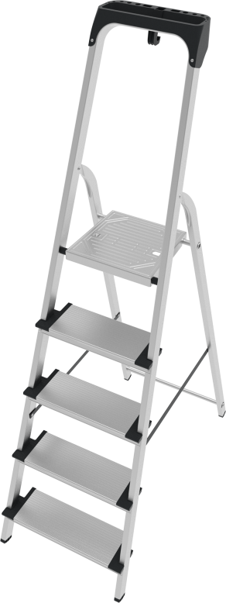
R
Aluminum stepladder with storage tray VIRA 4118 Standard
Spacious storage tray with a bucket for instruments and materials.
Very lightweight but extremely durable and reliable.
Easy to assemble and provides high level of comfort.
Steps and stiles are made from extruded aluminum profiles.
Wide steps with 130 mm depth.
Rifled surface of steps for maximum safety when ascending the ladder.
Sturdy six-times riveted step/side rail connection for more stability.
Rifled standing platform from galvanized steel.
Safety 600 mm barrier.
High-strength safety belts.
Plastic end caps for a stable position.
Optimized transport dimensions for storage and transportation.
Practicality and attention to each component guarantee safe work at any required height.
SKU | Steps | A, m | B, m | C, m | D, m | E, m | Volume, m3 | Weight, kg
4118103 | 1x3 | 0,59 | 1,29 | 0,42 | 2,59 | 0,128 | 0,06935 | 3,1
4118104 | 1x4 | 0,81 | 1,52 | 0,44 | 2,81 | 0,128 | 0,085606 | 3,9
4118105 | 1x5 | 1,03 | 1,76 | 0,47 | 3,03 | 0,128 | 0,105882 | 4,7
4118106 | 1x6 | 1,25 | 1,99 | 0,49 | 3,25 | 0,128 | 0,124813 | 5,7
4118107 | 1x7 | 1,47 | 2,23 | 0,52 | 3,47 | 0,128 | 0,148429 | 6,6
4118108 | 1x8 | 1,69 | 2,46 | 0,54 | 3,69 | 0,128 | 0,170035 | 7,5
zavodnv.ru/en

Slide 10
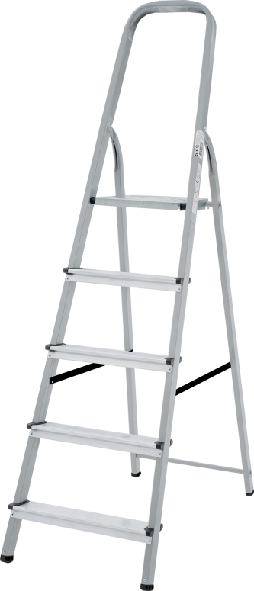
R
Steel stepladder with aluminium steps VIRA NV 4130 Standard
Extremely durable and reliable.
Can be easily adjusted and provides high level of comfort.
Powder-coated steel stiles and steps.
Steps are made from extruded aluminium profiles.
80 mm deep wide steps.
Rifled surface of the steps for maximum safety when ascending the ladder.
Sturdy six-time riveted step/side rail connection for more stability.
Rifled standing platform from galvanized steel.
600 mm safety barrier.
High-strength belts.
Firm positioning thanks to steady plastic end caps.
Optimised transport dimensions for storage and transportation.
Practicality and attention to every component guarantee safe work at any height.
SKU | Steps | A, m | B, m | C, m | D, m | E, m | Volume, m3 | Weight, kg
4130103 | 1x3 | 0,59 | 1,25 | 0,42 | 2,59 | 0,125 | 0,065625 | 4,5
4130104 | 1x4 | 0,81 | 1,48 | 0,44 | 2,81 | 0,125 | 0,0814 | 5,2
4130105 | 1x5 | 1,03 | 1,72 | 0,47 | 3,03 | 0,125 | 0,10105 | 6,1
4130106 | 1x6 | 1,25 | 1,95 | 0,49 | 3,25 | 0,125 | 0,119438 | 7
4130107 | 1x7 | 1,47 | 2,19 | 0,52 | 3,47 | 0,125 | 0,14235 | 8
4130108 | 1x8 | 1,69 | 2,42 | 0,54 | 3,69 | 0,125 | 0,16335 | 8,9
zavodnv.ru/en

Slide 11
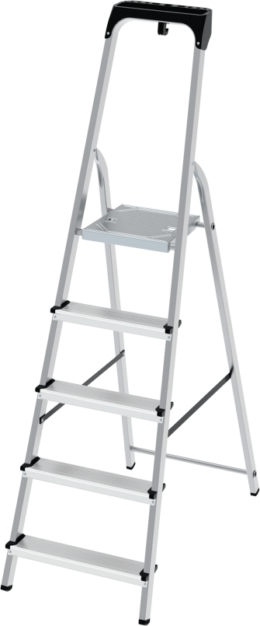
R
Aluminum steps steel stepladder with storage tray VIRA 4135 Standard
Spacious storage tray with a bucket for instruments and materials.
Very lightweight but extremely durable and reliable.
Easy to assemble and provides high level of comfort.
Powder-coated steel frame and beam racks.
Steps are made from extruded aluminum profiles.
Wide steps with 80 mm depth.
Rifled surface of steps for maximum safety when ascending the ladder.
Sturdy six-times riveted step/side rail connection for more stability.
Rifled standing platform from galvanized steel.
Safety 600 mm barrier.
High-strength safety belts.
Plastic end caps for a stable position.
Optimized transport dimensions for storage and transportation.
Practicality and attention to each component guarantee safe work at any required height.
SKU | Steps | A, m | B, m | C, m | D, m | E, m | Volume, m3 | Weight, kg
4135103 | 1x3 | 0,59 | 1,29 | 0,42 | 2,59 | 0,125 | 0,067725 | 4,6
4135104 | 1x4 | 0,81 | 1,52 | 0,44 | 2,81 | 0,125 | 0,0836 | 5,3
4135105 | 1x5 | 1,03 | 1,76 | 0,47 | 3,03 | 0,125 | 0,1034 | 6,2
4135106 | 1x6 | 1,25 | 1,99 | 0,49 | 3,25 | 0,125 | 0,121888 | 7,1
4135107 | 1x7 | 1,47 | 2,23 | 0,52 | 3,47 | 0,125 | 0,14495 | 8,1
4135108 | 1x8 | 1,69 | 2,46 | 0,54 | 3,69 | 0,125 | 0,16605 | 9
zavodnv.ru/en

Slide 12
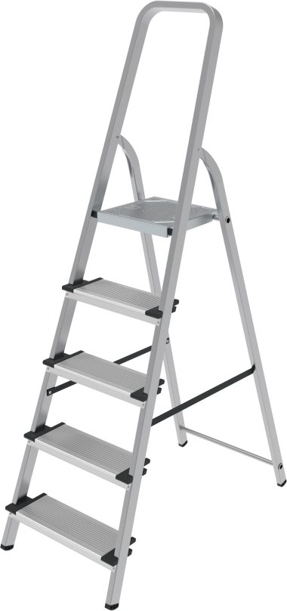
R
Aluminum 130 mm steps steel stepladder VIRA 4137 Standard
Very lightweight but extremely durable and reliable.
Easy to assemble and provides high level of comfort.
Powder-coated steel frame and beam racks.
Steps are made from extruded aluminum profiles.
Wide steps with 130 mm depth.
Rifled surface of steps for maximum safety when ascending the ladder.
Sturdy six-times riveted step/side rail connection for more stability.
Rifled standing platform from galvanized steel.
Safety 600 mm barrier.
High-strength safety belts.
Plastic end caps for a stable position.
Optimized transport dimensions for storage and transportation.
Practicality and attention to each component guarantee safe work at any required height.
SKU | Steps | A, m | B, m | C, m | D, m | E, m | Volume, m3 | Weight, kg
4137103 | 1x3 | 0,59 | 1,25 | 0,42 | 2,59 | 0,128 | 0,0672 | 4,9
4137104 | 1x4 | 0,81 | 1,48 | 0,44 | 2,81 | 0,128 | 0,083354 | 5,9
4137105 | 1x5 | 1,03 | 1,72 | 0,47 | 3,03 | 0,128 | 0,103475 | 7
4137106 | 1x6 | 1,25 | 1,95 | 0,49 | 3,25 | 0,128 | 0,122304 | 8,1
4137107 | 1x7 | 1,47 | 2,19 | 0,52 | 3,47 | 0,128 | 0,145766 | 9,4
4137108 | 1x8 | 1,69 | 2,42 | 0,54 | 3,69 | 0,128 | 0,16727 | 10,7
zavodnv.ru/en

Slide 13
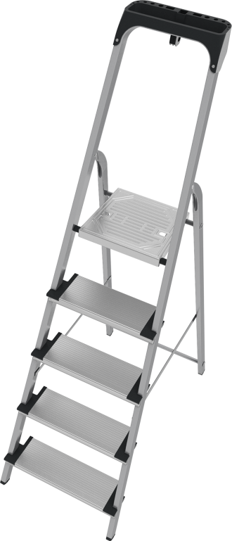
R
Aluminum 130 mm steps steel stepladder with storage tray VIRA 4138 Standard
Spacious storage tray with a bucket for instruments and materials.
Very lightweight but extremely durable and reliable.
Easy to assemble and provides high level of comfort.
Powder-coated steel frame and beam racks.
Steps are made from extruded aluminum profiles.
Wide steps with 130 mm depth.
Rifled surface of steps for maximum safety when ascending the ladder.
Sturdy six-times riveted step/side rail connection for more stability.
Rifled standing platform from galvanized steel.
Safety 600 mm barrier.
High-strength safety belts.
Plastic end caps for a stable position.
Optimized transport dimensions for storage and transportation.
Practicality and attention to each component guarantee safe work at any required height.
SKU | Steps | A, m | B, m | C, m | D, m | E, m | Volume, m3 | Weight, kg
4138103 | 1x3 | 0,59 | 1,29 | 0,42 | 2,59 | 0,128 | 0,06935 | 5
4138104 | 1x4 | 0,81 | 1,52 | 0,44 | 2,81 | 0,128 | 0,085606 | 6
4138105 | 1x5 | 1,03 | 1,76 | 0,47 | 3,03 | 0,128 | 0,105882 | 7,1
4138106 | 1x6 | 1,25 | 1,99 | 0,49 | 3,25 | 0,128 | 0,124813 | 8,2
4138107 | 1x7 | 1,47 | 2,23 | 0,52 | 3,47 | 0,128 | 0,148429 | 9,5
4138108 | 1x8 | 1,69 | 2,46 | 0,54 | 3,69 | 0,128 | 0,170035 | 10,8
zavodnv.ru/en

Slide 14
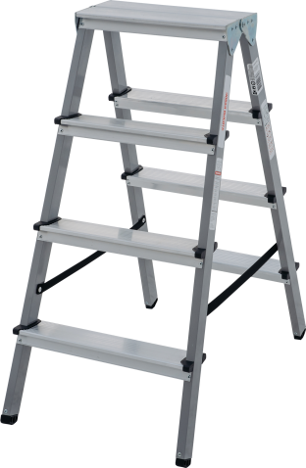
R
Steel stepladder with aluminium steps VIRA 4140 Standard
Extremely durable and reliable.
Can be easily adjusted and provides high level of comfort.
Powder-coated steel stiles.
Steps are made from extruded aluminium profiles.
80 mm deep wide steps.
Rifled surface of the steps for maximum safety when ascending the ladder.
Sturdy six-time riveted step/side rail connection for more stability.
High-strength belts.
Firm positioning thanks to steady plastic end caps.
Optimised transport dimensions for storage and transportation.
To save the time the double-sided access allows you not to change the position for use.
Practicality and attention to every component guarantee safe work at any height.
SKU | Steps | A, m | B, m | C, m | D, m | E, m | F, m | G, m | H, m | Volume, m3 | Weight, kg
4140102 | 2x2 | 0,44 | 0,16 | 0,48 | 0,42 | 0,35 | 0,4 | 2,44 | 0,163 | 0,031296 | 2,3
4140103 | 2x3 | 0,66 | 0,16 | 0,71 | 0,58 | 0,35 | 0,42 | 2,66 | 0,163 | 0,048607 | 3,3
4140104 | 2x4 | 0,88 | 0,16 | 0,95 | 0,74 | 0,35 | 0,45 | 2,88 | 0,163 | 0,069683 | 4,4
4140105 | 2x5 | 1,1 | 0,16 | 1,18 | 0,9 | 0,35 | 0,47 | 3,1 | 0,163 | 0,0904 | 5,4
4140106 | 2x6 | 1,32 | 0,16 | 1,41 | 1,06 | 0,35 | 0,5 | 3,32 | 0,163 | 0,114915 | 6,5
zavodnv.ru/en

Slide 15
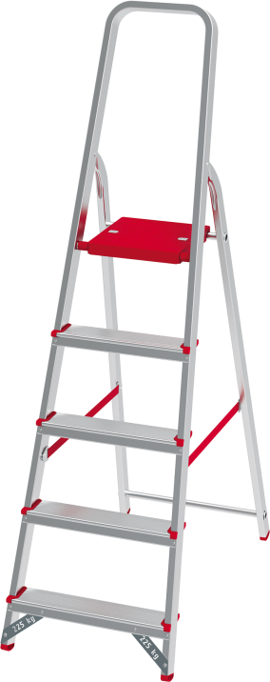
R
Aluminium stepladder VIRA 3110 Professional
Very lightweight but extremely durable and reliable.
It is easy to adjust and provides high level of comfort.
Steps and stiles are made from reinforced extruded aluminium profiles.
80 mm deep wide steps with the extended thickness.
Rifled surface of steps for maximum safety when ascending the ladder.
Sturdy six-times riveted step/side rail connection for more stability.
Powder-coated rifled standing platform.
600 mm safety barrier.
High-strength belts.
Firm positioning thanks to steady plastic end caps.
Optimised transport dimensions for storage and transportation.
Practicality and attention to each component guarantee safe work at any required height.
SKU | Steps | A, m | B, m | C, m | D, m | E, m | Volume, m3 | Weight, kg
3110103 | 1x3 | 0,59 | 1,25 | 0,42 | 2,59 | 0,125 | 0,065625 | 2,9
3110104 | 1x4 | 0,81 | 1,48 | 0,44 | 2,81 | 0,125 | 0,0814 | 3,6
3110105 | 1x5 | 1,03 | 1,72 | 0,47 | 3,03 | 0,125 | 0,10105 | 4,4
3110106 | 1x6 | 1,25 | 1,95 | 0,49 | 3,25 | 0,125 | 0,119438 | 5,2
3110107 | 1x7 | 1,47 | 2,19 | 0,52 | 3,47 | 0,125 | 0,14235 | 5,7
3110108 | 1x8 | 1,69 | 2,42 | 0,54 | 3,69 | 0,125 | 0,16335 | 6,4
zavodnv.ru/en

Slide 16
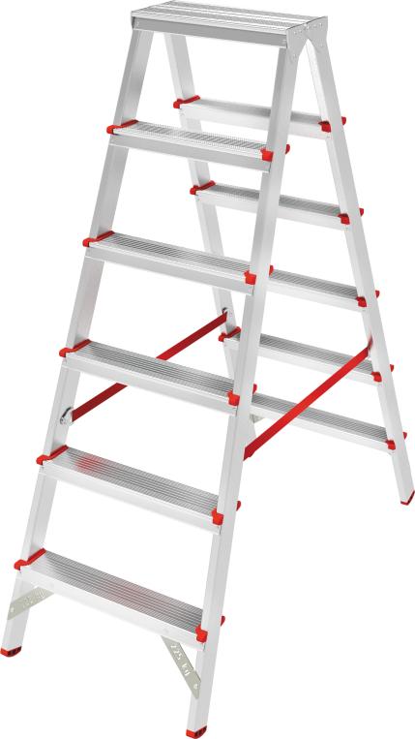
R
Aluminium two-sided stepladder VIRA 3120 Professional
Very lightweight but extremely durable and reliable.
It is easy to adjust and provides high level of comfort.
Steps and stiles are made from reinforced extruded aluminium profiles.
80 mm deep wide steps with the extended thickness.
Rifled surface of steps for maximum safety when ascending the ladder.
Sturdy six-time riveted step/side rail connection for more stability.
High-strength belts.
Firm positioning thanks to steady plastic end caps.
Optimised transport dimensions for storage and transportation.
To save the time the double-sided access allows you not to change the position for use.
Practicality and attention to every component guarantee safe work at any required height.
SKU | Steps | A, m | B, m | C, m | D, m | E, m | F, m | G, m | H, mm | Volume, m3 | Weight, kg
3120202 | 2x2 | 0,44 | 0,16 | 0,48 | 0,43 | 0,35 | 0,4 | 2,44 | 0,163 | 0,031296 | 2,4
3120203 | 2x3 | 0,66 | 0,16 | 0,71 | 0,59 | 0,35 | 0,42 | 2,66 | 0,163 | 0,048607 | 3,4
3120204 | 2x4 | 0,88 | 0,16 | 0,95 | 0,75 | 0,35 | 0,45 | 2,44 | 0,163 | 0,069683 | 4,3
3120205 | 2x5 | 1,1 | 0,16 | 1,18 | 0,91 | 0,35 | 0,47 | 2,66 | 0,163 | 0,0904 | 5,3
3120206 | 2x6 | 1,32 | 0,16 | 1,41 | 1,07 | 0,35 | 0,5 | 2,88 | 0,163 | 0,114915 | 6,3
zavodnv.ru/en

Slide 17
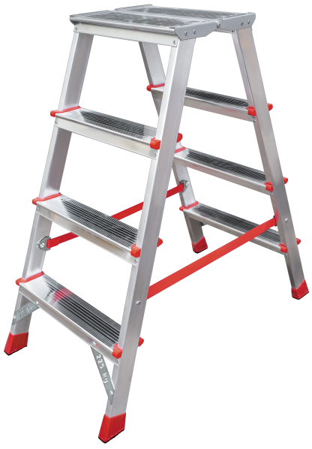
R
Two-sided stepladder with large top platform VIRA 3121 Professional
Standing platform 260×350 mm.
Very lightweight but extremely durable and reliable.
Easy to assemble and provides high level of comfort.
Steps and stiles are made from extruded aluminum profiles.
Wide steps with 80 mm depth.
Rifled surface of steps for maximum safety when ascending the ladder.
Sturdy six-times riveted step/side rail connection for more stability.
High-strength safety belts.
Plastic end caps for a stable position.
Optimized transport dimensions for storage and transportation.
Double-sided access allows to work from both sides, thus saving time.
Practicality and attention to each component guarantee safe work at any required height.
SKU | Steps | A, m | B, m | C, m | D, m | E, m | F, m | G, m | H, mm | Volume, m3 | Weight, kg
3121202 | 2x2 | 0,44 | 0,26 | 0,5 | 0,52 | 0,35 | 0,4 | 2,44 | 0,44 | 0,048 | 2,8
3121203 | 2x3 | 0,66 | 0,26 | 0,73 | 0,68 | 0,35 | 0,42 | 2,66 | 0,66 | 0,07665 | 3,7
3121204 | 2x4 | 0,88 | 0,26 | 0,96 | 0,84 | 0,35 | 0,45 | 2,44 | 0,88 | 0,108 | 4,7
3121205 | 2x5 | 1,1 | 0,26 | 1,19 | 1 | 0,35 | 0,47 | 2,66 | 1,1 | 0,139825 | 5,7
3121206 | 2x6 | 1,32 | 0,26 | 1,43 | 1,16 | 0,35 | 0,5 | 2,88 | 1,32 | 0,17875 | 6,7
zavodnv.ru/en

Slide 18
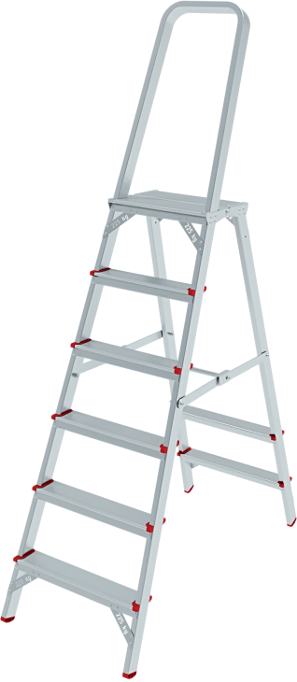
R
Aluminum stepladder with large top platform VIRA 3130 Professional
Very lightweight but extremely durable and reliable.
Easy to adjust and provides high level of comfort.
Unilaterally ascendable.
Steps and stiles are made from reinforced extruded aluminium profiles.
Wide steps with a depth of 80 mm.
Rifled surface of steps for maximum safety when ascending the ladder.
Sturdy six-times riveted step/side rail connection for more stability.
Safe rifled standing platform.
There is a seat place on the supporting leg.
600 mm safety barrier.
Rigid metal ties provide a secure fixation in the working position — firm positioning thanks to steady plastic end caps.
Optimised transport dimensions for storage and transportation.
Practicality and attention to each component guarantee safe work at any required height.
SKU | Steps | A, m | B, m | C, m | С*, m | D, m | E, m | F, m | Volume, m3 | Weight, kg
3130103 | 1х3 | 0,66 | 1,33 | 0,43 | - | 0,68 | 2,66 | 0,25 | 1,521254 | 4,9
3130104 | 1х4 | 0,88 | 1,56 | 0,45 | - | 0,84 | 2,88 | 0,25 | 2,02176 | 5,9
3130105 | 1х5 | 1,1 | 1,79 | 0,47 | - | 1 | 3,1 | 0,25 | 2,60803 | 6,6
3130106 | 1х6 | 1,32 | 2,03 | 0,5 | - | 1,16 | 3,32 | 0,25 | 3,3698 | 7,4
3130107 | 1х7 | 1,54 | 2,26 | 0,52 | - | 1,32 | 3,54 | 0,25 | 4,160208 | 8,3
3130108 | 1х8 | 1,76 | 2,5 | 0,55 | - | 1,48 | 3,76 | 0,25 | 5,17 | 9,1
3130109 | 1х9 | 1,98 | 2,73 | 0,57 | 0,77 | 1,64 | 3,98 | 0,25 | 6,193278 | 11,4
3130110 | 1х10 | 2,2 | 2,96 | 0,6 | 0,77 | 1,8 | 4,2 | 0,25 | 7,4592 | 12,2
3130111 | 1х11 | 2,43 | 3,2 | 0,62 | 0,79 | 1,96 | 4,43 | 0,25 | 8,78912 | 13,3
3130112 | 1х12 | 2,65 | 3,43 | 0,64 | 0,82 | 2,12 | 4,65 | 0,25 | 10,20768 | 14,1
zavodnv.ru/en

Slide 19
R
Stepladder with large top platform anodizing VIRA 3130A Professional
Anodizing to protect hands, clothing and contact surfaces from marks and to facilitate care.
Suitable for clean work.
Very lightweight but extremely durable and reliable.
Easy to adjust and provides high level of comfort.
Unilaterally ascendable.
Steps and stiles are made from reinforced extruded aluminium profiles.
Wide steps with a depth of 80 mm.
Rifled surface of steps for maximum safety when ascending the ladder.
Sturdy six-times riveted step/side rail connection for more stability.
Safe rifled standing platform.
There is a seat place on the supporting leg.
600 mm safety barrier.
Rigid metal ties provide a secure fixation in the working position — firm positioning thanks to steady plastic end caps.
Optimised transport dimensions for storage and transportation.
Practicality and attention to each component guarantee safe work at any required height.
SKU | Steps | A, m | B, m | C, m | С*, m | D, m | E, m | F, m | Volume, m3 | Weight, kg
3130103A | 1х3 | 0,66 | 1,33 | 0,43 | - | 0,68 | 2,66 | 0,25 | 1,521254 | 4,9
3130104A | 1х4 | 0,88 | 1,56 | 0,45 | - | 0,84 | 2,88 | 0,25 | 2,02176 | 5,9
3130105A | 1х5 | 1,1 | 1,79 | 0,47 | - | 1 | 3,1 | 0,25 | 2,60803 | 6,6
3130106A | 1х6 | 1,32 | 2,03 | 0,5 | - | 1,16 | 3,32 | 0,25 | 3,3698 | 7,4
3130107A | 1х7 | 1,54 | 2,26 | 0,52 | - | 1,32 | 3,54 | 0,25 | 4,160208 | 8,3
3130108A | 1х8 | 1,76 | 2,5 | 0,55 | - | 1,48 | 3,76 | 0,25 | 5,17 | 9,1
3130109A | 1х9 | 1,98 | 2,73 | 0,57 | 0,77 | 1,64 | 3,98 | 0,25 | 6,193278 | 11,4
3130110A | 1х10 | 2,2 | 2,96 | 0,6 | 0,77 | 1,8 | 4,2 | 0,25 | 7,4592 | 12,2
3130111A | 1х11 | 2,43 | 3,2 | 0,62 | 0,79 | 1,96 | 4,43 | 0,25 | 8,78912 | 13,3
3130112A | 1х12 | 2,65 | 3,43 | 0,64 | 0,82 | 2,12 | 4,65 | 0,25 | 10,20768 | 14,1
3130103A | 1х13 | 0,66 | 1,33 | 0,43 | - | 0,68 | 2,66 | 0,25 | 1,521254 | 4,9
3130104A | 1х14 | 0,88 | 1,56 | 0,45 | - | 0,84 | 2,88 | 0,25 | 2,02176 | 5,9
zavodnv.ru/en

Slide 20
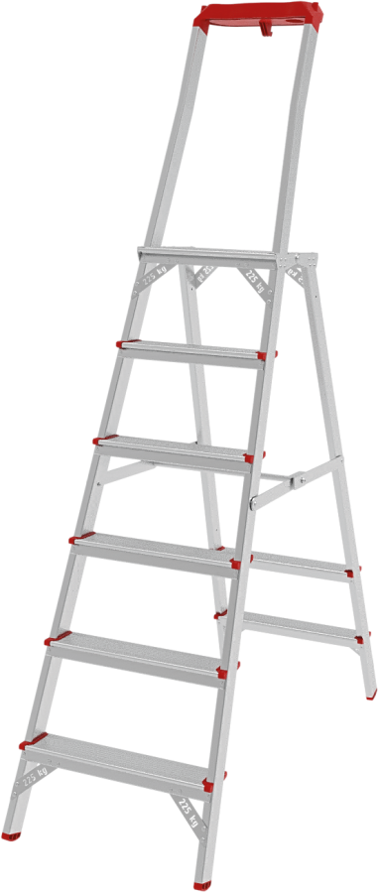
R
Stepladder with the storage tray and large top platform VIRA 3135 Professional
Spacious aluminium storage tray for material and tools.
Very lightweight but extremely durable and reliable.
Easy to adjust and provides high level of comfort.
Unilaterally ascendable.
Steps and stiles are made from reinforced extruded aluminium profiles.
Wide steps with a depth of 80 mm.
Rifled surface of steps for maximum safety when ascending the ladder.
Sturdy six-times riveted step/side rail connection for more stability.
Safe rifled standing platform.
There is a seat place on the supporting leg.
600 mm safety barrier.
Rigid metal ties provide a secure fixation in the working position.
Firm positioning thanks to steady plastic end caps.
Optimised transport dimensions for storage and transportation.
Practicallity and attention to each component guarantee safe work at any required height.
SKU | Steps | A, m | B, m | C, m | С*, m | D, m | E, m | F, m | Volume, m3 | Weight, kg
3135103 | 1х3 | 0,66 | 1,36 | 0,43 | - | 0,68 | 2,66 | 0,25 | 0,1462 | 5,1
3135104 | 1х4 | 0,88 | 1,59 | 0,45 | - | 0,84 | 2,88 | 0,25 | 0,178875 | 6,1
3135105 | 1х5 | 1,1 | 1,82 | 0,47 | - | 1 | 3,1 | 0,25 | 0,21385 | 6,9
3135106 | 1х6 | 1,32 | 2,06 | 0,5 | - | 1,16 | 3,32 | 0,25 | 0,2575 | 7,7
3135107 | 1х7 | 1,54 | 2,29 | 0,52 | - | 1,32 | 3,54 | 0,25 | 0,2977 | 8,6
3135108 | 1х8 | 1,76 | 2,53 | 0,55 | - | 1,48 | 3,76 | 0,25 | 0,347875 | 9,4
3135109 | 1х9 | 1,98 | 2,76 | 0,57 | 0,74 | 1,64 | 3,98 | 0,25 | 0,3933 | 11,6
3135110 | 1х10 | 2,2 | 2,99 | 0,6 | 0,77 | 1,8 | 4,2 | 0,25 | 0,4485 | 12,4
3135111 | 1х11 | 2,43 | 3,23 | 0,62 | 0,79 | 1,96 | 4,43 | 0,25 | 0,50065 | 13,6
3135112 | 1х12 | 2,65 | 3,46 | 0,64 | 0,82 | 2,12 | 4,65 | 0,25 | 0,5536 | 14,4
zavodnv.ru/en

Slide 21
R
Stepladder with the storage tray and large top platform anodizing VIRA 3135A
Anodizing to protect hands, clothing and contact surfaces from marks and to facilitate care.
Suitable for clean work.
Spacious aluminium storage tray for material and tools.
Very lightweight but extremely durable and reliable.
Easy to adjust and provides high level of comfort.
Unilaterally ascendable.
Steps and stiles are made from reinforced extruded aluminium profiles.
Wide steps with a depth of 80 mm.
Rifled surface of steps for maximum safety when ascending the ladder.
Sturdy six-times riveted step/side rail connection for more stability.
Safe rifled standing platform.
There is a seat place on the supporting leg.
600 mm safety barrier.
Rigid metal ties provide a secure fixation in the working position.
Firm positioning thanks to steady plastic end caps.
Optimised transport dimensions for storage and transportation.
Practicallity and attention to each component guarantee safe work at any required height.
SKU | Steps | A, m | B, m | C, m | С*, m | D, m | E, m | F, m | Volume, m3 | Weight, kg
3135103 | 1х3 | 0,66 | 1,36 | 0,43 | - | 0,68 | 2,66 | 0,25 | 0,1462 | 5,1
3135104 | 1х4 | 0,88 | 1,59 | 0,45 | - | 0,84 | 2,88 | 0,25 | 0,178875 | 6,1
3135105 | 1х5 | 1,1 | 1,82 | 0,47 | - | 1 | 3,1 | 0,25 | 0,21385 | 6,9
3135106 | 1х6 | 1,32 | 2,06 | 0,5 | - | 1,16 | 3,32 | 0,25 | 0,2575 | 7,7
3135107 | 1х7 | 1,54 | 2,29 | 0,52 | - | 1,32 | 3,54 | 0,25 | 0,2977 | 8,6
3135108 | 1х8 | 1,76 | 2,53 | 0,55 | - | 1,48 | 3,76 | 0,25 | 0,347875 | 9,4
3135109 | 1х9 | 1,98 | 2,76 | 0,57 | 0,74 | 1,64 | 3,98 | 0,25 | 0,3933 | 11,6
3135110 | 1х10 | 2,2 | 2,99 | 0,6 | 0,77 | 1,8 | 4,2 | 0,25 | 0,4485 | 12,4
3135111 | 1х11 | 2,43 | 3,23 | 0,62 | 0,79 | 1,96 | 4,43 | 0,25 | 0,50065 | 13,6
3135112 | 1х12 | 2,65 | 3,46 | 0,64 | 0,82 | 2,12 | 4,65 | 0,25 | 0,5536 | 14,4
zavodnv.ru/en

Slide 22
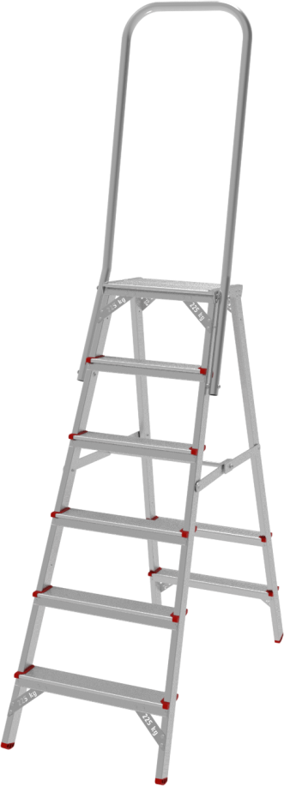
R
Stepladder with large safety barrier 800 mm VIRA 3136 Professional
Very lightweight but extremely durable and reliable.
Easy to adjust and provides high level of comfort.
Unilaterally ascendable.
Steps and stiles are made from reinforced extruded aluminium profiles.
Wide steps with a depth of 80 mm.
Rifled surface of steps for maximum safety when ascending the ladder.
Sturdy six-times riveted step/side rail connection for more stability.
Safe folding rifled aluminum platform 300×270 mm.
There is a seat place on the supporting leg.
800 mm safety barrier.
Rigid metal ties provide a secure fixation in the working position.
Firm positioning thanks to steady plastic end caps.
Optimised transport dimensions for storage and transportation.
Practicallity and attention to each component guarantee safe work at any required height.
SKU | Steps | A, m | B, m | C, m | С*, m | D, m | E, m | F, m | G, m | Volume, m3 | Weight, kg
3136104 | 1х4 | 0,88 | 1,76 | 0,45 | - | 0,84 | 2,88 | 0,25 | 1,15 | 0,129375 | 6,6
3136105 | 1х5 | 1,1 | 1,99 | 0,47 | - | 1 | 3,1 | 0,25 | 1,19 | 0,139825 | 7,4
3136106 | 1х6 | 1,32 | 2,22 | 0,5 | - | 1,16 | 3,32 | 0,25 | 1,42 | 0,1775 | 8,1
3136107 | 1х7 | 1,54 | 2,45 | 0,52 | - | 1,32 | 3,54 | 0,25 | 1,65 | 0,2145 | 9,1
3136108 | 1х8 | 1,76 | 2,68 | 0,55 | - | 1,48 | 3,76 | 0,25 | 1,88 | 0,2585 | 9,9
3136109 | 1х9 | 1,98 | 2,91 | 0,57 | 0,74 | 1,64 | 3,98 | 0,25 | 2,11 | 0,300675 | 12,1
3136110 | 1х10 | 2,2 | 3,14 | 0,6 | 0,77 | 1,8 | 4,2 | 0,25 | 2,34 | 0,351 | 13
3136111 | 1х11 | 2,43 | 3,37 | 0,62 | 0,79 | 1,96 | 4,43 | 0,25 | 2,57 | 0,39835 | 14,1
3136112 | 1х12 | 2,65 | 3,6 | 0,64 | 0,82 | 2,12 | 4,65 | 0,25 | 2,8 | 0,448 | 15
zavodnv.ru/en

Slide 23
R
Stepladder with large safety barrier 800 mm anodizing VIRA 3136A Professional
Anodizing to protect hands, clothing and contact surfaces from marks and to facilitate care.
Suitable for clean work.
Very lightweight but extremely durable and reliable.
Easy to adjust and provides high level of comfort.
Unilaterally ascendable.
Steps and stiles are made from reinforced extruded aluminium profiles.
Wide steps with a depth of 80 mm.
Rifled surface of steps for maximum safety when ascending the ladder.
Sturdy six-times riveted step/side rail connection for more stability.
Safe folding rifled aluminum platform 300×270 mm.
There is a seat place on the supporting leg.
800 mm safety barrier.
Rigid metal ties provide a secure fixation in the working position.
Firm positioning thanks to steady plastic end caps.
Optimised transport dimensions for storage and transportation.
Practicallity and attention to each component guarantee safe work at any required height.
SKU | Steps | A, m | B, m | C, m | С*, m | D, m | E, m | F, m | G, m | Volume, m3 | Weight, kg
3136104A | 1х4 | 0,88 | 1,76 | 0,45 | - | 0,84 | 2,88 | 0,25 | 1,15 | 0,129375 | 6,6
3136105A | 1х5 | 1,1 | 1,99 | 0,47 | - | 1 | 3,1 | 0,25 | 1,19 | 0,139825 | 7,4
3136106A | 1х6 | 1,32 | 2,22 | 0,5 | - | 1,16 | 3,32 | 0,25 | 1,42 | 0,1775 | 8,1
3136107A | 1х7 | 1,54 | 2,45 | 0,52 | - | 1,32 | 3,54 | 0,25 | 1,65 | 0,2145 | 9,1
3136108A | 1х8 | 1,76 | 2,68 | 0,55 | - | 1,48 | 3,76 | 0,25 | 1,88 | 0,2585 | 9,9
3136109A | 1х9 | 1,98 | 2,91 | 0,57 | 0,74 | 1,64 | 3,98 | 0,25 | 2,11 | 0,300675 | 12,1
3136110A | 1х10 | 2,2 | 3,14 | 0,6 | 0,77 | 1,8 | 4,2 | 0,25 | 2,34 | 0,351 | 13
3136111A | 1х11 | 2,43 | 3,37 | 0,62 | 0,79 | 1,96 | 4,43 | 0,25 | 2,57 | 0,39835 | 14,1
3136112A | 1х12 | 2,65 | 3,6 | 0,64 | 0,82 | 2,12 | 4,65 | 0,25 | 2,8 | 0,448 | 15
zavodnv.ru/en

Slide 24
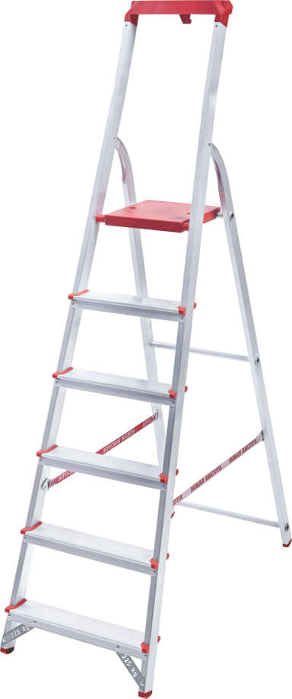
R
Aluminium stepladder with the storage tray VIRA 3150 Professional
The stepladder is equipped with a roomy storage tray for tools and stuff.
Very lightweight but extremely durable and reliable.
It is easy to adjust and provides high level of comfort.
Steps and stiles made from reinforced extruded aluminium profiles.
80 mm deep wide steps with the extended thickness.
Rifled surface of the steps for maximum safety when ascending the ladder.
Sturdy six-times riveted step/side rail connection for more stability.
Powder-coated rifled standing platform.
600 mm safety barrier.
High-strength belts.
Firm positioning thanks to steady plastic end caps.
Optimised transport dimensions for storage and transportation.
Practicality and attention to every component guarantee safe work at any required height.
SKU | Steps | A, m | B, m | C, m | D, m | E, m | Volume, m3 | Weight, kg
3150103 | 1x3 | 0,59 | 1,28 | 0,42 | 2,59 | 0,127 | 0,068275 | 3,4
3150104 | 1x4 | 0,81 | 1,52 | 0,44 | 2,81 | 0,127 | 0,084938 | 4
3150105 | 1x5 | 1,03 | 1,74 | 0,47 | 3,03 | 0,127 | 0,103861 | 4,7
3150106 | 1x6 | 1,25 | 1,98 | 0,49 | 3,25 | 0,127 | 0,123215 | 5,4
3150107 | 1x7 | 1,47 | 2,22 | 0,52 | 3,47 | 0,127 | 0,146609 | 6,1
3150108 | 1x8 | 1,69 | 2,49 | 0,54 | 3,69 | 0,127 | 0,170764 | 6,9
zavodnv.ru/en

Slide 25
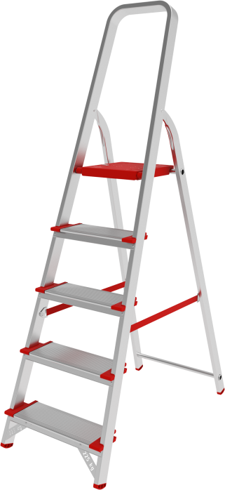
R
Aluminium stepladder with the storage tray VIRA 5110 Industrial
Equipped with roomy storage tray for tools and stuff.
Very lightweight but extremely durable and reliable.
Easy to adjust and provides high level of comfort.
Steps and stiles are made from reinforced extruded aluminium profiles.
Wide steps with depth of 130 mm.
Rifled surface of steps for maximum safety when ascending the ladder.
Sturdy six-time riveted step/side rail connection for more stability.
Powder-coated rifled safe standing platform from galvanized steel.
600 mm safety barrier.
High-strength belts.
Firm positioning thanks to steady plastic end caps.
Optimised transport dimensions for storage and transportation.
Practicallity and attention to every component guarantee safe work at any required height.
SKU | Steps | A, m | B, m | C, m | D, m | E, m | Volume, m3 | Weight, kg
5110103 | 1x3 | 0,59 | 1,25 | 0,42 | 2,59 | 0,132 | 0,0693 | 3,2
5110104 | 1x4 | 0,81 | 1,48 | 0,44 | 2,81 | 0,132 | 0,085958 | 4,1
5110105 | 1x5 | 1,03 | 1,72 | 0,47 | 3,03 | 0,132 | 0,106709 | 5,1
5110106 | 1x6 | 1,25 | 1,95 | 0,49 | 3,25 | 0,132 | 0,126126 | 6,1
5110107 | 1x7 | 1,47 | 2,19 | 0,52 | 3,47 | 0,132 | 0,150322 | 6,8
5110108 | 1x8 | 1,69 | 2,42 | 0,54 | 3,69 | 0,132 | 0,172498 | 7,8
zavodnv.ru/en

Slide 26
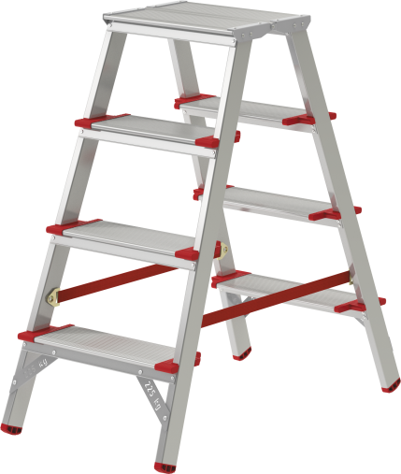
R
Aluminium stepladder VIRA 5120 Industrial
Very lightweight but extremely durable and reliable.
Easy to adjust and provides high level of comfort.
Steps and stiles are made from reinforced extruded aluminium profiles.
Wide steps with an extended depth of 130 mm.
Extended standing platform with a width of 260 mm.
Rifled surface of steps for maximum safety when ascending the ladder.
Sturdy six-time riveted step/side rail connection for more stability.
High-strength belts.
Firm positioning thanks to steady plastic end caps.
Optimised transport dimensions for storage and transportation.
To save the time the double-sided access allows you not to change the position for use.
Practicallity and attention to every component guarantee safe work at any required height.
SKU | Steps | A, m | B, m | C, m | D, m | E, m | F, m | G, m | H, mm | Volume, m3 | Weight, kg
5110103 | 2x2 | 0,44 | 0,26 | 0,49 | 0,52 | 0,35 | 0,4 | 2,44 | 0,26 | 0,05096 | 3
5110104 | 2x3 | 0,66 | 0,26 | 0,72 | 0,68 | 0,35 | 0,42 | 2,66 | 0,26 | 0,078624 | 4,3
5110105 | 2x4 | 0,88 | 0,26 | 0,96 | 0,84 | 0,35 | 0,45 | 2,44 | 0,26 | 0,11232 | 5,6
5110106 | 2x5 | 1,1 | 0,26 | 1,19 | 1 | 0,35 | 0,47 | 2,66 | 0,26 | 0,145418 | 7
5110107 | 2x6 | 1,32 | 0,26 | 1,42 | 1,16 | 0,35 | 0,5 | 2,88 | 0,26 | 0,1846 | 8,4
zavodnv.ru/en

Slide 27
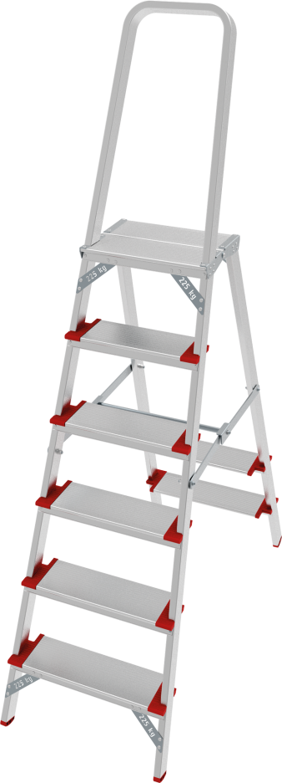
R
Aluminum stepladder with large top platform VIRA 5130 Industrial
Very lightweight but extremely durable and reliable.
Easy to adjust and provides high level of comfort.
Unilaterally ascendable.
Steps and stiles are made from reinforced extruded aluminum profiles.
Wide steps with a depth of 130 mm.
Rifled surface of steps for maximum safety when ascending the ladder.
Sturdy six-times riveted step/side rail connection for more stability.
Safe rifled standing platform.
Seat place on the supporting leg.
600 mm safety barrier.
Rigid metal ties provide a secure fixation in the working position.
Optimized transport dimensions for storage and transportation.
Practicality and attention to each component guarantee safe work at any required height.
SKU | Steps | A, m | B, m | C, m | С*, m | D, m | E, m | F, m | Volume, m3 | Weight, kg
5130103 | 1х3 | 0,66 | 1,33 | 0,43 | - | 0,68 | 2,66 | 0,25 | 0,142975 | 5,4
5130104 | 1х4 | 0,88 | 1,56 | 0,45 | - | 0,84 | 2,88 | 0,25 | 0,1755 | 6,7
5130105 | 1х5 | 1,1 | 1,79 | 0,47 | - | 1 | 3,1 | 0,25 | 0,210325 | 7,7
5130106 | 1х6 | 1,32 | 2,03 | 0,5 | - | 1,16 | 3,32 | 0,25 | 0,25375 | 8,7
5130107 | 1х7 | 1,54 | 2,26 | 0,52 | - | 1,32 | 3,54 | 0,25 | 0,2938 | 9,9
5130108 | 1х8 | 1,76 | 2,5 | 0,55 | - | 1,48 | 3,76 | 0,25 | 0,34375 | 10,9
5130109 | 1х9 | 1,98 | 2,73 | 0,57 | 0,77 | 1,64 | 3,98 | 0,25 | 0,389025 | 13,5
5130110 | 1х10 | 2,2 | 2,96 | 0,6 | 0,77 | 1,8 | 4,2 | 0,25 | 0,444 | 14,6
5130111 | 1х11 | 0,66 | 1,33 | 0,43 | - | 0,68 | 2,66 | 0,25 | 0,496 | 5,4
5130112 | 1х12 | 0,88 | 1,56 | 0,45 | - | 0,84 | 2,88 | 0,25 | 0,5488 | 6,7
zavodnv.ru/en

Slide 28
R
Aluminum stepladder with large top platform anodizing VIRA 5130A Industrial
Anodizing to protect hands, clothing and contact surfaces from marks and to facilitate care.
Suitable for clean work.
Very lightweight but extremely durable and reliable.
Easy to adjust and provides high level of comfort.
Unilaterally ascendable.
Steps and stiles are made from reinforced extruded aluminum profiles.
Wide steps with a depth of 130 mm.
Rifled surface of steps for maximum safety when ascending the ladder.
Sturdy six-times riveted step/side rail connection for more stability.
Safe rifled standing platform.
Seat place on the supporting leg.
600 mm safety barrier.
Rigid metal ties provide a secure fixation in the working position.
Optimized transport dimensions for storage and transportation.
Practicality and attention to each component guarantee safe work at any required height.
SKU | Steps | A, m | B, m | C, m | С*, m | D, m | E, m | F, m | Volume, m3 | Weight, kg
5130103А | 1х3 | 0,66 | 1,33 | 0,43 | - | 0,68 | 2,66 | 0,25 | 0,142975 | 5,4
5130104А | 1х4 | 0,88 | 1,56 | 0,45 | - | 0,84 | 2,88 | 0,25 | 0,1755 | 6,7
5130105А | 1х5 | 1,1 | 1,79 | 0,47 | - | 1 | 3,1 | 0,25 | 0,210325 | 7,7
5130106А | 1х6 | 1,32 | 2,03 | 0,5 | - | 1,16 | 3,32 | 0,25 | 0,25375 | 8,7
5130107А | 1х7 | 1,54 | 2,26 | 0,52 | - | 1,32 | 3,54 | 0,25 | 0,2938 | 9,9
5130108А | 1х8 | 1,76 | 2,5 | 0,55 | - | 1,48 | 3,76 | 0,25 | 0,34375 | 10,9
5130109А | 1х9 | 1,98 | 2,73 | 0,57 | 0,77 | 1,64 | 3,98 | 0,25 | 0,389025 | 13,5
5130110А | 1х10 | 2,2 | 2,96 | 0,6 | 0,77 | 1,8 | 4,2 | 0,25 | 0,444 | 14,6
5130111А | 1х11 | 0,66 | 1,33 | 0,43 | - | 0,68 | 2,66 | 0,25 | 0,496 | 5,4
5130112А | 1х12 | 0,88 | 1,56 | 0,45 | - | 0,84 | 2,88 | 0,25 | 0,5488 | 6,7
zavodnv.ru/en

Slide 29
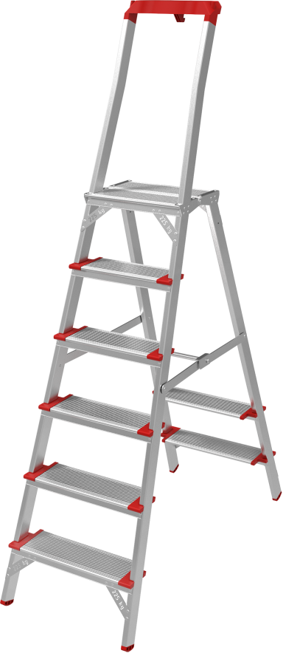
R
Stepladder with storage tray and large top platform VIRA 5135 Industrial
Very lightweight but extremely durable and reliable.
Easy to adjust and provides high level of comfort.
Unilaterally ascendable.
Steps and stiles are made from reinforced extruded aluminum profiles.
Wide steps with a depth of 130 mm.
Rifled surface of steps for maximum safety when ascending the ladder.
Sturdy six-times riveted step/side rail connection for more stability.
Safe rifled standing platform.
Seat place on the supporting leg.
600 mm safety barrier.
Rigid metal ties provide a secure fixation in the working position end caps.
Optimized transport dimensions for storage and transportation.
Practicality and attention to each component guarantee safe work at any required height.
SKU | Steps | A, m | B, m | C, m | С*, m | D, m | E, m | F, m | Volume, m3 | Weight, kg
5135103 | 1х3 | 0,66 | 1,36 | 0,43 | - | 0,68 | 2,66 | 0,25 | 0,1462 | 5,6
5135104 | 1х4 | 0,88 | 1,59 | 0,45 | - | 0,84 | 2,88 | 0,25 | 0,178875 | 7
5135105 | 1х5 | 1,1 | 1,82 | 0,47 | - | 1 | 3,1 | 0,25 | 0,21385 | 7,9
5135106 | 1х6 | 1,32 | 2,06 | 0,5 | - | 1,16 | 3,32 | 0,25 | 0,2575 | 8,7
5135107 | 1х7 | 1,54 | 2,29 | 0,52 | - | 1,32 | 3,54 | 0,25 | 0,2977 | 10,1
5135108 | 1х8 | 1,76 | 2,53 | 0,55 | - | 1,48 | 3,76 | 0,25 | 0,347875 | 11,2
5135109 | 1х9 | 1,98 | 2,76 | 0,57 | 0,74 | 1,64 | 3,98 | 0,25 | 0,3933 | 13,8
5135110 | 1х10 | 2,2 | 2,99 | 0,6 | 0,77 | 1,8 | 4,2 | 0,25 | 0,4485 | 15
5135111 | 1х11 | 2,43 | 3,23 | 0,62 | 0,79 | 1,96 | 4,43 | 0,25 | 0,50065 | 16,4
5135112 | 1х12 | 2,65 | 3,46 | 0,64 | 0,82 | 2,12 | 4,65 | 0,25 | 0,5536 | 17,5
zavodnv.ru/en

Slide 30
R
Stepladder with storage tray and large top platform anodizing VIRA 5135A
Anodizing to protect hands, clothing and contact surfaces from marks and to facilitate care.
Suitable for clean work.
Very lightweight but extremely durable and reliable.
Easy to adjust and provides high level of comfort.
Unilaterally ascendable.
Steps and stiles are made from reinforced extruded aluminum profiles.
Wide steps with a depth of 130 mm.
Rifled surface of steps for maximum safety when ascending the ladder.
Sturdy six-times riveted step/side rail connection for more stability.
Safe rifled standing platform.
Seat place on the supporting leg.
600 mm safety barrier.
Rigid metal ties provide a secure fixation in the working position end caps.
Optimized transport dimensions for storage and transportation.
Practicality and attention to each component guarantee safe work at any required height.
SKU | Steps | A, m | B, m | C, m | С*, m | D, m | E, m | F, m | Volume, m3 | Weight, kg
5135103А | 1х3 | 0,66 | 1,36 | 0,43 | - | 0,68 | 2,66 | 0,25 | 0,1462 | 5,6
5135104А | 1х4 | 0,88 | 1,59 | 0,45 | - | 0,84 | 2,88 | 0,25 | 0,178875 | 7
5135105А | 1х5 | 1,1 | 1,82 | 0,47 | - | 1 | 3,1 | 0,25 | 0,21385 | 7,9
5135106А | 1х6 | 1,32 | 2,06 | 0,5 | - | 1,16 | 3,32 | 0,25 | 0,2575 | 8,7
5135107А | 1х7 | 1,54 | 2,29 | 0,52 | - | 1,32 | 3,54 | 0,25 | 0,2977 | 10,1
5135108А | 1х8 | 1,76 | 2,53 | 0,55 | - | 1,48 | 3,76 | 0,25 | 0,347875 | 11,2
5135109А | 1х9 | 1,98 | 2,76 | 0,57 | 0,74 | 1,64 | 3,98 | 0,25 | 0,3933 | 13,8
5135110А | 1х10 | 2,2 | 2,99 | 0,6 | 0,77 | 1,8 | 4,2 | 0,25 | 0,4485 | 15
5135111А | 1х11 | 2,43 | 3,23 | 0,62 | 0,79 | 1,96 | 4,43 | 0,25 | 0,50065 | 16,4
5135112А | 1х12 | 2,65 | 3,46 | 0,64 | 0,82 | 2,12 | 4,65 | 0,25 | 0,5536 | 17,5
zavodnv.ru/en

Slide 31
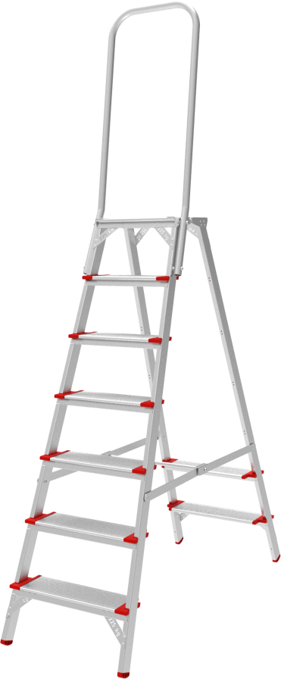
R
Aluminum stepladder with large safety barrier of 800 mm VIRA 5136 Industrial
Very lightweight but extremely durable and reliable.
Easy to adjust and provides high level of comfort.
Unilaterally ascendable.
Steps and stiles are made from reinforced extruded aluminum profiles.
Wide steps with a depth of 130 mm.
Rifled surface of steps for maximum safety when ascending the ladder.
Sturdy six-times riveted step/side rail connection for more stability.
Safe rifled standing platform.
Seat place on the supporting leg.
600 mm safety barrier.
Rigid metal ties provide a secure fixation in the working position end caps.
Optimized transport dimensions for storage and transportation.
Practicality and attention to each component guarantee safe work at any required height.
SKU | Steps | A, m | B, m | C, m | С*, m | D, m | E, m | F, m | G, m | Volume, m3 | Weight, kg
5136104 | 1х4 | 0,88 | 1,76 | 0,45 | - | 0,84 | 2,88 | 0,25 | 1,15 | 0,129375 | 7,4
5136105 | 1х5 | 1,1 | 1,99 | 0,47 | - | 1 | 3,1 | 0,25 | 1,19 | 0,139825 | 8,3
5136106 | 1х6 | 1,32 | 2,22 | 0,5 | - | 1,16 | 3,32 | 0,25 | 1,42 | 0,1775 | 9,3
5136107 | 1х7 | 1,54 | 2,45 | 0,52 | - | 1,32 | 3,54 | 0,25 | 1,65 | 0,2145 | 10,5
5136108 | 1х8 | 1,76 | 2,68 | 0,55 | - | 1,48 | 3,76 | 0,25 | 1,88 | 0,2585 | 11,6
5136109 | 1х9 | 1,98 | 2,91 | 0,57 | 0,74 | 1,64 | 3,98 | 0,25 | 2,11 | 0,300675 | 14,3
5136110 | 1х10 | 2,2 | 3,14 | 0,6 | 0,77 | 1,8 | 4,2 | 0,25 | 2,34 | 0,351 | 15,5
5136111 | 1х11 | 2,43 | 3,37 | 0,62 | 0,79 | 1,96 | 4,43 | 0,25 | 2,57 | 0,39835 | 16,8
5136112 | 1х12 | 2,65 | 3,6 | 0,64 | 0,82 | 2,12 | 4,65 | 0,25 | 2,8 | 0,448 | 18
zavodnv.ru/en

Slide 32
R
Aluminum stepladder with large safety barrier of 800 mm anodizing VIRA 5136A
Anodizing to protect hands, clothing and contact surfaces from marks and to facilitate care.
Suitable for clean work.
Very lightweight but extremely durable and reliable.
Easy to adjust and provides high level of comfort.
Unilaterally ascendable.
Steps and stiles are made from reinforced extruded aluminum profiles.
Wide steps with a depth of 130 mm.
Rifled surface of steps for maximum safety when ascending the ladder.
Sturdy six-times riveted step/side rail connection for more stability.
Safe rifled standing platform.
Seat place on the supporting leg.
600 mm safety barrier.
Rigid metal ties provide a secure fixation in the working position end caps.
Optimized transport dimensions for storage and transportation.
Practicality and attention to each component guarantee safe work at any required height.
SKU | Steps | A, m | B, m | C, m | С*, m | D, m | E, m | F, m | G, m | Volume, m3 | Weight, kg
5136104А | 1х4 | 0,88 | 1,76 | 0,45 | - | 0,84 | 2,88 | 0,25 | 1,15 | 0,129375 | 7,4
5136105А | 1х5 | 1,1 | 1,99 | 0,47 | - | 1 | 3,1 | 0,25 | 1,19 | 0,139825 | 8,3
5136106А | 1х6 | 1,32 | 2,22 | 0,5 | - | 1,16 | 3,32 | 0,25 | 1,42 | 0,1775 | 9,3
5136107А | 1х7 | 1,54 | 2,45 | 0,52 | - | 1,32 | 3,54 | 0,25 | 1,65 | 0,2145 | 10,5
5136108А | 1х8 | 1,76 | 2,68 | 0,55 | - | 1,48 | 3,76 | 0,25 | 1,88 | 0,2585 | 11,6
5136109А | 1х9 | 1,98 | 2,91 | 0,57 | 0,74 | 1,64 | 3,98 | 0,25 | 2,11 | 0,300675 | 14,3
5136110А | 1х10 | 2,2 | 3,14 | 0,6 | 0,77 | 1,8 | 4,2 | 0,25 | 2,34 | 0,351 | 15,5
5136111А | 1х11 | 2,43 | 3,37 | 0,62 | 0,79 | 1,96 | 4,43 | 0,25 | 2,57 | 0,39835 | 16,8
5136112А | 1х12 | 2,65 | 3,6 | 0,64 | 0,82 | 2,12 | 4,65 | 0,25 | 2,8 | 0,448 | 18
zavodnv.ru/en

Slide 33
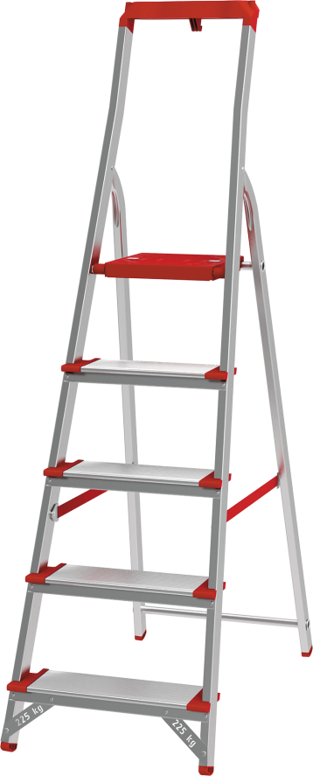
R
Aluminium stepladder with the storage tray VIRA 5150 Industrial
Equipped with roomy storage tray for tools and stuff.
Very lightweight but extremely durable and reliable.
Easy to adjust and provides high level of comfort.
Steps and stiles are made from reinforced extruded aluminium profiles.
Wide steps with depth of 130 mm.
Rifled surface of steps for maximum safety when ascending the ladder.
Sturdy six-time riveted step/side rail connection for more stability.
Powder-coated rifled safe standing platform from galvanized steel.
600 mm safety barrier.
High-strength belts.
Firm positioning thanks to steady plastic end caps.
Optimised transport dimensions for storage and transportation.
Practicallity and attention to every component guarantee safe work at any required height.
SKU | Steps | A, m | B, m | C, m | D, m | E, m | Volume, m3 | Weight, kg
5150103 | 1x3 | 0,59 | 1,28 | 0,42 | 2,59 | 0,132 | 0,070963 | 3,7
5150104 | 1x4 | 0,81 | 1,52 | 0,44 | 2,81 | 0,132 | 0,088282 | 4,5
5150105 | 1x5 | 1,03 | 1,74 | 0,47 | 3,03 | 0,132 | 0,10795 | 5,5
5150106 | 1x6 | 1,25 | 1,98 | 0,49 | 3,25 | 0,132 | 0,128066 | 6,3
5150107 | 1x7 | 1,47 | 2,22 | 0,52 | 3,47 | 0,132 | 0,152381 | 7,2
5150108 | 1x8 | 1,69 | 2,49 | 0,54 | 3,69 | 0,132 | 0,177487 | 8,2
zavodnv.ru/en

Slide 34
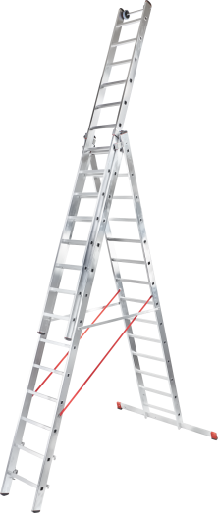
R
Three-section aluminium rung ladder VIRA 5230 Industrial
Three-section versatile rung ladder of 6 functions.
Can be used on steps and stairs.
Top ladder fitted with wall wheels for comfortable wall movement.
Strong, weather resistant belts.
Extra aluminium rigid connection.
Rungs and stiles are made from extruded profiles.
Strong riveting connects rungs and stiles, providing extra reliability and lasting quality.
Rifled rung pitch of 260 mm for maximum safety when ascending the ladder.
Plastic protective clips on the rungs and on the guide brackets for comfortable use.
Sturdy guide brackets from extruded profile fix the extendable section reliably in any working position.
Four hooks from extruded profile with safety blockers.
Wide cross bar provides extra stability.
Firmly seated in the stiles and cross bar end caps are made from 2 component plastic where hard. component is Responsible for security fixing and soft component prevents risk of slipping.
The upper section can be easily pulled out and be used as a separate single leaning rung ladder.
Durable and totally repairable.
SKU | Steps | A, m | B, m | C, m | D, m | E, m | F, m | G, m | H, m | I, m | J, mm | K, mm | L, m | M, m | N, m | Volume, m3 | Weight, kg
5230306 | 3х6 | 1,72 | 1,62 | 2,95 | 3,28 | 4,46 | 0,40 | 1,00 | 3,70 | 2,50 | 72 | 23 | 0,20 | 1,73 | 0,55 | 0,1903 | 13,7
5230307 | 3х7 | 1,98 | 1,87 | 3,20 | 4,06 | 5,19 | 0,40 | 1,00 | 4,19 | 3,02 | 72 | 23 | 0,20 | 1,99 | 0,55 | 0,2189 | 15,4
5230308 | 3х8 | 2,24 | 2,11 | 3,44 | 4,84 | 5,92 | 0,40 | 1,00 | 4,68 | 3,54 | 72 | 23 | 0,20 | 2,25 | 0,55 | 0,2475 | 16,9
5230309 | 3х9 | 2,50 | 2,36 | 3,68 | 5,62 | 6,66 | 0,40 | 1,00 | 5,17 | 4,06 | 72 | 23 | 0,20 | 2,51 | 0,55 | 0,2761 | 18,6
5230310 | 3х10 | 2,76 | 2,60 | 3,93 | 6,40 | 7,39 | 0,40 | 1,20 | 5,66 | 4,58 | 72 | 23 | 0,20 | 2,77 | 0,55 | 0,3047 | 20,3
5230311 | 3х11 | 3,02 | 2,84 | 4,17 | 7,18 | 8,12 | 0,40 | 1,20 | 6,15 | 5,10 | 72 | 23 | 0,20 | 3,03 | 0,55 | 0,3333 | 21,9
5230312 | 3х12 | 3,28 | 3,09 | 4,42 | 7,96 | 8,85 | 0,40 | 1,20 | 6,64 | 5,62 | 72 | 23 | 0,20 | 3,29 | 0,55 | 0,3619 | 23,5
5230313 | 3х13 | 3,54 | 3,34 | 4,67 | 8,74 | 9,60 | 0,40 | 1,20 | 7,13 | 6,14 | 99 | 23 | 0,26 | 3,55 | 0,55 | 0,50765 | 31,7
5230314 | 3х14 | 3,80 | 3,59 | 4,91 | 9,52 | 10,33 | 0,40 | 1,50 | 7,62 | 6,66 | 99 | 23 | 0,26 | 3,81 | 0,55 | 0,54483 | 34,2
5230315 | 3х15 | 4,06 | 3,83 | 5,16 | 10,30 | 11,06 | 0,40 | 1,50 | 8,11 | 7,18 | 99 | 23 | 0,26 | 4,07 | 0,55 | 0,58201 | 36,1
5230316 | 3х16 | 4,32 | 4,08 | 5,40 | 11,08 | 11,80 | 0,40 | 1,50 | 8,60 | 7,70 | 99 | 23 | 0,26 | 4,33 | 0,55 | 0,61919 | 38,2
5230317 | 3х17 | 4,58 | 4,32 | 5,65 | 11,86 | 12,53 | 0,40 | 1,50 | 9,09 | 8,22 | 99 | 23 | 0,26 | 4,59 | 0,55 | 0,65637 | 40,2
zavodnv.ru/en

Slide 35
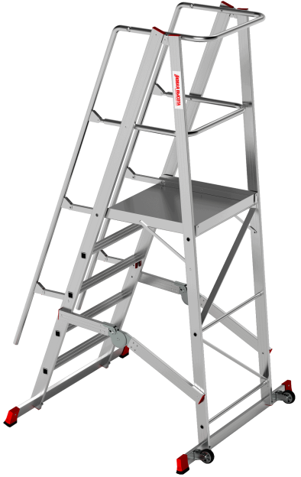
R
Mobile folding ladder with platform VIRA 5540 Industrial
Ergonomic stairs with platform for safe operation.
Easy to work with, to move and storage due to the folding design and castors of 125 mm diameter.
Steps with 100 mm depth from extruded aluminum profile for comfortable ascending platform is fenced from three sides for long and safe work.
1,1 m railing height.
Max load 150 kg.
Wide cross bar.
Guardrail for safe and ergonomic working at heights.
SKU | Steps | A, m | B, m | C, m | D, m | H, m | J, m | K, m | Volume, m3 | Weight, kg
5540104 | 1х4 | 0,98 | 1,05 | 2,05 | 1,20 | 0,77 | 2,41 | 0,26 | 0,49 | 26
5540105 | 1х5 | 1,22 | 1,05 | 2,29 | 1,20 | 0,77 | 2,67 | 0,26 | 0,54 | 28
5540106 | 1х6 | 1,47 | 1,05 | 2,54 | 1,20 | 0,77 | 2,93 | 0,26 | 0,59 | 30
5540107 | 1х7 | 1,71 | 1,05 | 2,78 | 1,20 | 0,77 | 3,19 | 0,26 | 0,64 | 32
5540108 | 1х8 | 1,95 | 1,05 | 3,03 | 1,20 | 0,77 | 3,45 | 0,26 | 0,69 | 34
5540109 | 1х9 | 2,20 | 1,05 | 3,27 | 1,20 | 0,77 | 3,71 | 0,26 | 0,75 | 36
zavodnv.ru/en

Slide 36
R
Confidence in every step!
188360, Russia
Plot 2, territory Promzona 2
Gatchina, Gatchinskiy district,
Leningradskiy region
“Novaya Vysota” Scaffolds Plant
zavodnv.ru/en

